Slide 1
Lecture 21: Toxic Chemicals
Prof. Theising
Environmental Economics
Econ 4075

Slide 2
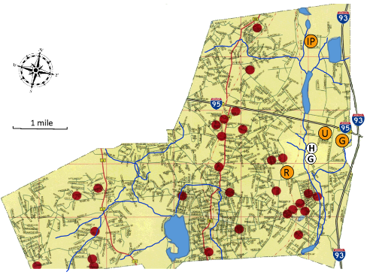
Woburn, MA: 1960s-1980s
From 1964-1979, drinking water for the town of Woburn was drawn from Wells G and H (shown at right)
Over that same period, an apparent child leukemia cluster forms (red dots); 28 children were diagnosed, of whom many died.
In 1979, water samples drawn by the state showed that both wells were heavily contaminated with trichloroethylene (TCE)
  Both wells immediately shut down.

Slide 3
Woburn, MA: 1960s-1980s
Where did this TCE come from?
  Industrial facilities (located at points R, U, IP, and G at right) were dumping waste directly onto their land.
  Many workers handling chemicals at these facilities also developed cancers.
  Watershed modelling suggestive that this is source of water pollution
In 1982, a group of families, led by one victim’s mother, Anne Anderson, filed suit against these facilities seeking compensatory and punitive damages.
  Anderson v. Cryovac, Inc. (805 F. 2d 1)

Slide 4

Woburn, MA: 1960s-1980s
In sum, the tort lawsuit worked through the courts from 1982-1990.
Initial hopes to “make an example of industry” in court did not come to fruition.
  By 1986, plaintiffs had settled out of court with 2 defendant facilities for a modest $10m.
  The third facility was found not liable, a finding upheld on appeals.
The plaintiffs’ expenses to build their scientific case ultimately reached around $6m
  The plaintiff’s lawyer eventually declared bankruptcy due to the case, but on the plus side, became immortalized by John Travolta in a 1998 film.

Slide 5
Takeaways from this incident?
Causally proving harm to human health or the environment from chemical exposure can be HARD.
Industry knows the fact above, and it can create poor incentives.
  Industry has $$$, lawyers, lobbyists to protect its interests
  Parties damaged by chemical exposure typically do not.
Government knows the fact above, but in the American setting, regulation on chemical use only possible with causal proof of harm.

Slide 6
Roadmap
Context: the US chemical industry and use
Mitigating damages: liability versus regulation
Information provision
Overview: federal regulation of chemicals
Shapira & Zingales, 2023
Wrapping up

Slide 7
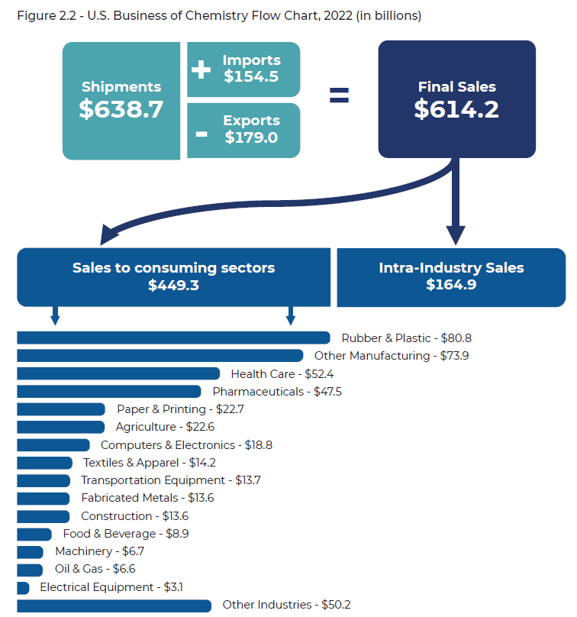
The US chemical industry
Second largest producer globally, behind China.
  Sales of chemicals in 2022: $614 billion (~2% of US GDP).
A 2020 report from the National Academies of Science finds value added is much higher: 25% of US GDP depends directly on downstream use of chemicals.
An economy without industrial chemicals would be largely unrecognizable.
Source: ACC, 2023

Slide 8
Chemical toxicity, exposure, and risk
Not all chemicals generate risk to human health or the environment.
As a general framework, risk is the product of hazard and exposure.
  The hazard of a chemical is its inherent ability to cause an adverse effect on health (e.g., cancer, birth defects, skin rash).
  Exposure is how a person comes into contact with a chemical (e.g., inhalation, ingestion, dermal) and can be described in terms of its magnitude (how much), frequency (how often), and duration (how long).
So health risk is greater when chemical exposure or/and hazard is large.

Slide 9
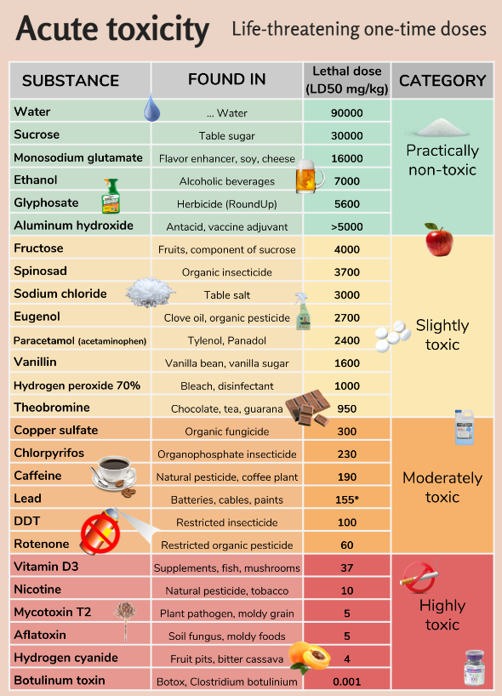
Chemical toxicity is relative…
Effects from toxic exposure may be acute or chronic.
Acute toxicity effects occurs from a single dose and are short-term in nature. Could be “minor” things like a rash, eye/throat irritation, dizziness. Or “major” things like fetal loss, unconsciousness, or even death.
Chronic toxicity effects are long-term in nature and may take years to show up after repeated exposures. Think things like asthma, cancer, or organ damage.

Slide 10
Chemicals exposure varies by use
Who might be exposed to chemicals? Where might this occur?

Slide 11
Chemicals exposure varies by use
Who might be exposed to chemicals? Where might this occur?
Workers (in manufacturing, processing, agriculture, and more…)
  Ex: construction workers could have occupational inhalation exposure to asbestos, may lead to mesothelioma
  Ex: commercial dishwashers could have occupational dermal exposure to 1,4 dioxane, with high enough frequency could lead to liver and kidney damage.
Occupational bystanders
  Ex: office workers at an industrial facility may inhale fugitive chemical emissions.
General population
  Ex: communities along industrial fencelines may be exposed to toxic air or water releases
  Ex: pregnant woman using lotion containing phthalates could expose themselves, their fetus, and their potential grandchildren to reproductive, neurological, or obesity effects
Notes:
Workers most likely suffer from information asymmetry problems.
Occupational bystanders and gen pop impacts could be related to information asymmetry but also to externalities.

Slide 12
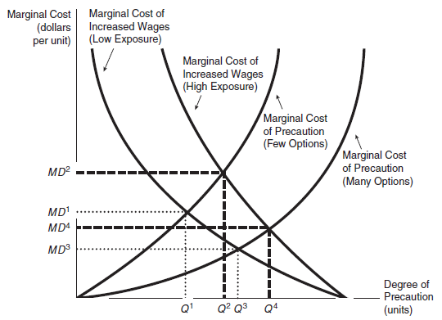
Worker chemical exposure, in theory…
Consider the standard firm profit max problem*:
The firm uses a toxic chemical in its production process, resulting in worker exposure (costly to the worker).
Since the firm and workers have perfect information, the firm can respond in two ways:
  reduce risk through protective measures.
  pay workers a compensating risk premium.
As shown in figure, cost-minimizing equilibrium yields the optimal combination
*But in reality, what is the market failure here?
Notes:
The first type of cost, the marginal increase in wages, is drawn to reflect the fact that the lower the level of precaution, the higher the wage bill. Two such curves are drawn to reflect high-exposure and low-exposure situations. The high-exposure case assumes larger numbers of workers are exposed than in the low-exposure case. The low-exposure cost curve rises more slowly because the situation is less dangerous at the margin.
The second type of curve, the marginal cost of providing precaution, reflects an increasing marginal cost. The two different curves depict different production situations. A firm with a few expensive precautionary options will face a steeply sloped marginal cost curve, while a firm with many cheaper options will face a lower marginal cost at every comparable degree of precaution chosen.
Because the marginal increased wages curve accurately reflects marginal damages (since the higher wages are demanded by workers to compensate them for damages), these market equilibria are also efficient. Thus, the efficient resolution of the occupational hazards problem varies not only from substance to substance, but also from plant to plant. As long as this stylized view of the world is correct, the market will tailor the appropriate degree of precaution to the situation.
But wages may not reflect the actual risk. The ability of the worker to respond to a hazardous situation depends on his or her knowledge of the seriousness of the danger. With toxic substances, that knowledge is likely to be incomplete. Consequently, the marginal increased wages function may be artificially rotated toward the origin. In this case the employer would choose too little precaution.

Slide 13
Roadmap
Context: the US chemical industry and use
Mitigating damages: liability versus regulation
Information provision
Overview: federal regulation of chemicals
Shapira & Zingales, 2023
Wrapping up

Slide 14
A law & econ digression: liability versus regulation
Consider the following: institutions can address health damages from chemical exposure in a few different ways
  Ex-post (after the damage occurs) via liability through the judicial system
  Ex-ante (before the damage occurs) via assignment of property rights
  Ex-ante via regulation through legislative system
In classic theory (e.g. Coase, 1960), any of these methods will attain the social optimum.*
Why?
*(assuming no transaction costs or limits to bargaining, and full information on cost and damage functions). See Behrer et al (2021) for extended model.

Slide 15
A law & econ digression: liability versus regulation
Consider the following: one can address health damages from chemical exposure in a few ways
  Ex-post (after the damage occurs) via liability through the judicial system
  Ex-ante (before the damage occurs) via assignment of property rights
  Ex-ante via regulation through legislative system
In classic theory (e.g. Coase, 1960), any of these methods will attain the social optimum.*
Okay… back in the real world, what are some disadvantages of each approach?
*(assuming no transaction costs or limits to bargaining, and full information on cost and damage functions). See Behrer et al (2021) for extended model.

Slide 16
A law & econ digression: liability versus regulation
Liability | Property rights | Regulation
Polluting firms may make decisions based on short-run timelines. | Bargaining becomes unrealistically difficult when many parties are harmed. | Gov’t may (or may not) have less information about risk than polluters; hard to set optimal policy with limited info
Polluting firms might be incapable of paying for the full magnitude of harm done (though insurance can mitigate) | How to initially allocate the rights? | Enforcement and administration of a regulation is often costly.
Victims might not file suit for harm done for reasons of ignorance, expected cost, or death before trial.
In the US, we regulate chemical safety, but simply complying with a regulation doesn’t necessarily relieve a party of liability… see Kolstad et al (1990) for argument that this is optimal policy.

Slide 17
Some examples of litigation over chemical liability
Philip Morris (Tobacco Products): in 2002, were ordered to pay punitive damages of $28 billion to a single smoker for lung cancer she suffered. Appeals dragged on for 9 years, by which point this was lowered to $28 million. The victim didn’t live to see the end of the trial.
Owens Corning (Asbestos Insulation): in 1998, settled over 176,000 tort lawsuits for $1.2 billion. Lawsuits continued, ultimately resulting in their bankruptcy and creation of a personal injury trust.
Johnson and Johnson (Baby Powder): currently facing 50,000+ tort lawsuits alleging cancer that resulted from use of its talc-based baby powder. Expected liability is $10 billion +.
Bayer (via Monsanto): ongoing lawsuits alleging cancers resulting from glyphosate (Roundup) exposure. So far 100,000 lawsuits have been settled for around $11 billion. 40,000+ cases ongoing.

Slide 18
Roadmap
Context: the US chemical industry and use
Mitigating damages: liability versus regulation
Information provision
Overview: federal regulation of chemicals
Shapira & Zingales, 2023
Wrapping up

Slide 19
Recall: market failures justify regulation.
Which of these apply in the chemicals context?
Externalities?
Market Power?
Information Asymmetry?
We’ll now briefly discuss some policies to mitigate information issues.

Slide 20
The Toxic Releases Inventory (TRI)
The Emergency Planning and Community Right to Know Act created the Toxic Releases Inventory (TRI) program in 1983.
Facilities that release any of roughly 800 highly toxic chemicals to air, water, or land, are required to report to this program every year.
The data’s release does engender economic responses:
  Property values: Mastromonaco (2015), Moulton et al (2023)
  Stock market returns: Hamilton (1995), Konar and Cohen (2001)
  Emission reductions: Hamilton (1999), Konar and Cohen (1997)
  Worker chemical exposure: Finger and Gamper-Rabindran (2013)

Slide 21
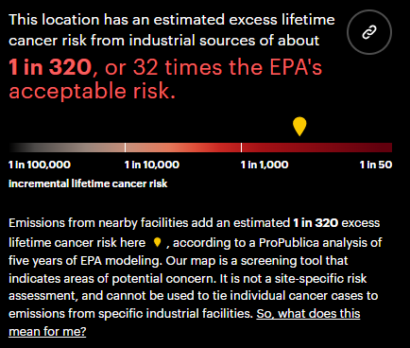
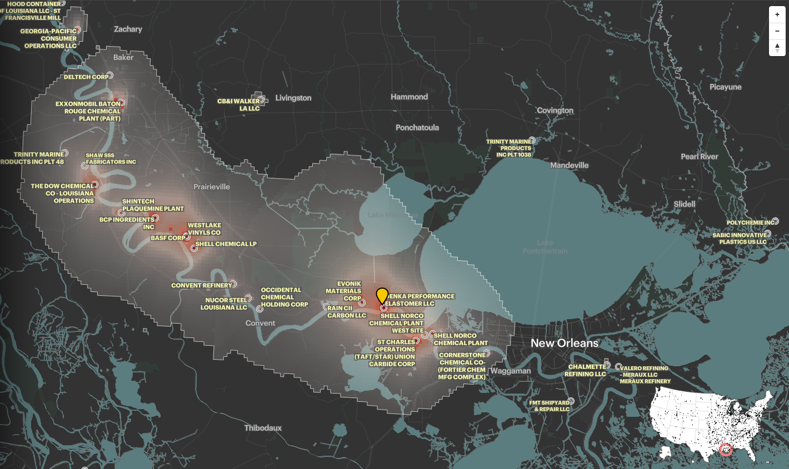
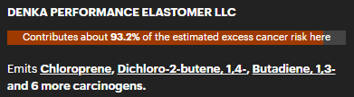
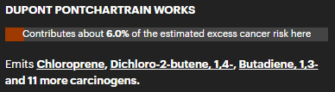
TRI data on air releases highlight risk contributers
Source: https://projects.propublica.org/toxmap/

Slide 22
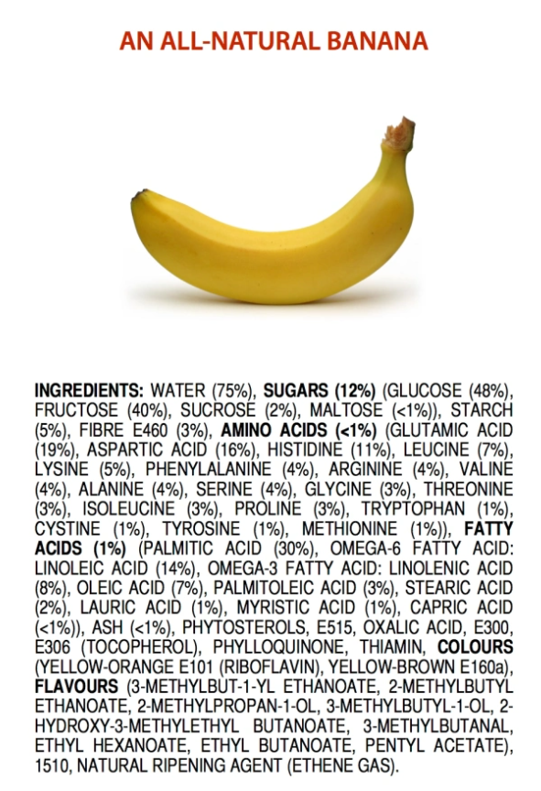
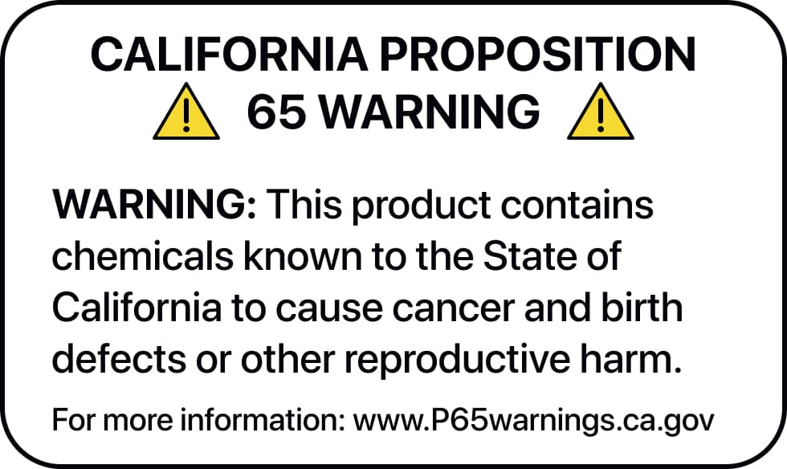
Is consumer product labelling effective?
  Several state and federal institutions set guidelines for product labelling.
  Warnings and labelling can empower individuals to make informed decisions about chemical exposure taking into account their own risk tolerance.
  The nature of label or warning matters: undifferentiated and abundant warnings lead to consumers ignoring them: it’s bad policy to cry wolf over a puppy.

Slide 23
Roadmap
Context: the US chemical industry and use
Mitigating damages: liability versus regulation
Information provision
Overview: federal regulation of chemicals
Shapira & Zingales, 2023
Wrapping up

Slide 24
The US chemical regulatory environment
Federal regulation of chemicals in the US is a tangled web of jurisdiction. A summary:
Where is the chemical found? | Who has authority to regulate? | Which statute?
In drinking water | EPA | SDWA
In surface/ambient water | EPA | CWA
In the air | EPA | CAA
As an active ingredient in pesticides | EPA | FIFRA
In consumer products | CPSC | CPSA
In food/drugs/cosmetics | FDA | several
In the workplace | OSHA | OSHA
At (hazardous) waste sites | EPA (+ATSDR) | RCRA (+CERCLA)
Anywhere in commerce, excluding pesticides, tobacco, specified nuclear material, firearms and ammunition, food, food additives, drugs, and cosmetics | EPA | TSCA

Slide 25
Federal Insecticide, Fungicide, and Rodenticide Act
Since 1972, all pesticides must be registered with the EPA before sale, use, or distribution.
Applicants must demonstrate that the pesticide “will not generally cause unreasonable adverse effects on the environment.” Applicants pay for the required testing.
  Unlike in other environmental statutes, EPA has interpreted “unreasonable” to mean instances where the economic, social, and environmental costs outweigh the benefits of use (i.e. crop yield and downstream economic effects)”. The courts have generally upheld this interpretation.
  Applicants also demonstrate the pesticide prevents unreasonable human dietary risk from residues in or on any food product.
  FIFRA also requires registered pesticides to display labels clearly showing ingredients, warning or precautionary statements, and directions for use (amongst others).
  If EPA believes risks to workers using a pesticide are excessive, under FIFRA it can require workplace standards or protective clothing.

Slide 26
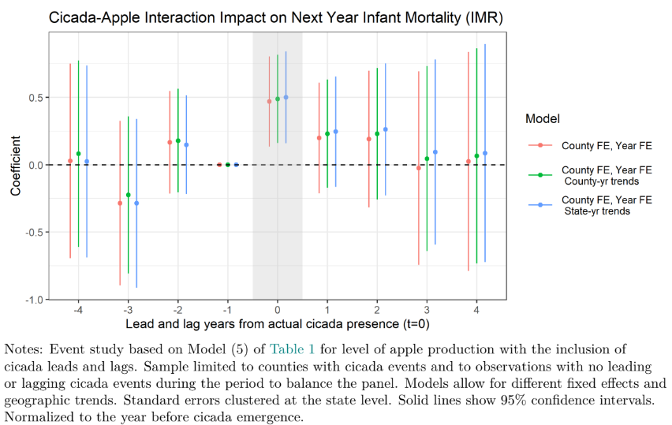
Federal Insecticide, Fungicide, and Rodenticide Act
  Could more health protective pesticide regulation be economy-improving? A few thoughts:
  EPA estimates of health costs are often rudimentary due to resource constraints. Underestimates?
    Taylor (2022) uses exogenous variation in county level application of pesticides due to cicada cycles and finds impacts to infant mortality, test scores, and HS drop out rates.
  US agricultural trade is often restricted due to partner countries’ stricter pesticide restrictions.
  Largest US pesticide exposures to agricultural (often migrant) workers. EJ concern?

Slide 27
Toxic Substances Control Act: History
In 1976, Congress passed TSCA to address growing concerns about the use of toxic chemicals in US commerce. Its aim was to identify and control potentially dangerous chemicals.
Congress envisioned that TSCA would be implemented in tandem with other fragmented environmental statutes that deal with the release of chemicals after their creation.
Instead, TSCA’s intent is that the harmful effects of chemicals are investigated in the laboratory rather than turning up in injuries to human beings or the environment after full-scale production has begun.
Notes:
Senators quoting studies in the 70s suggest 60+% of cancers are due to environmental toxics.

Slide 28
TSCA, the original
TSCA is a broad set of laws, but its key provisions are under:
Section 4 gives EPA authority to require commercial testing on new or existing chemical substances for their effects on the environment and human health.
Section 5 gives EPA authority to regulate new chemicals before their manufacture, and to regulate existing chemicals for significant new uses.
Section 6 gives EPA authority to regulate existing chemicals that are determined to present an unreasonable risk to the environment and human health.
Section 8 gives EPA authority to require commercial actors to collect, maintain, and submit data on certain chemical substances, maintain records and data concerning adverse reactions or human health impacts, and report information on substantial risks to health.

Slide 29
TSCA + the 2016 Lautenberg Act
Despite its intent, in hindsight, TSCA had some major shortcomings that made its implementation ineffective.
All chemicals existing in commerce were “grandfathered in” with no safety standards required.
Strong industry reliance on “trade secrets” exemption for data disclosure.
Exercise of Section 4 test order authority to learn about a chemical required evidence that the chemical presented an unreasonable risk: a catch-22.
Efforts to manage existing chemical risk were largely deemed a failure, especially after a Section 6 ban of asbestos was overturned on appeal in 1991.
In 2016, Congress amended TSCA to address these and other shortcomings. These amendments, passed with bipartisan support, are known as the Lautenberg Act.
Both environmentalists and industry walked away with victories…

Slide 30
Information gathering: Sections 4 and 8
EPA is required in to compile and maintain an inventory of chemical substances that are manufactured, processed, or imported in the United States.
  As of August, 86,718 chemicals of which 42,242 are actively used.
EPA also requires manufacturers and importers to provide information on inventory chemical production volumes and uses. This is housed in the CDR database.
Chemical manufacturers, distributers, importers and processors are required to keep records of adverse health reactions to a chemical and notify EPA immediately if they obtain information suggesting a chemical presents substantial risk.
Finally, under new Section 4 authority, EPA can issue test orders to industry for development of information on a chemical’s environmental or human health impacts.

Slide 31
Section 5: regulation of new chemicals
If a chemical is not already listed on the TSCA inventory, it is a new chemical and therefore subject to Section 5.
Any entity planning to manufacture or import a new chemical substance is required to provide EPA a premanufacture notice with available data.
Due to the Lautenberg Act, EPA is now required to make an affirmative risk determination before a new chemical can proceed to market.
If information is insufficient or implies an unreasonable risk from a chemical, EPA can require testing, prohibit or limit its use to the extent necessary to remove unreasonable risk.
Similarly, significant new uses of an existing chemical are subject to an EPA risk determination; the agency can prohibit or limit the use should unreasonable risk exist.
Of 1561 completed PMN/SNU since 2016, 13 (0.8%) had unreasonable risk. (430 cases withdrawn)

Slide 32
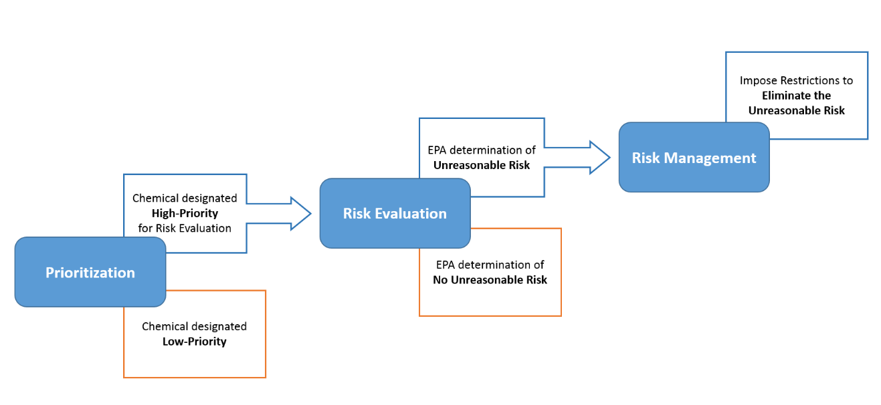
Section 6: regulation of existing chemicals
The Lautenberg Act revisions resulted in a significant overhaul of existing chemical regulation.
EPA has 42,000+ chemicals to assess and must now attain now statutory deadlines in evaluating and managing existing chemical risk.
This process occurs in three steps, shown at left.

Slide 33
Section 6: evaluating unreasonable risk
Once a high-priority chemical moves into risk evaluation, the process consists of:
A scoping exercise, where analytical approaches and methods are selected, and conditions of the chemicals use are designated.
A hazard assessment, where adverse health or environmental effects are identified.
An exposure assessment, where the likely duration, intensity, frequency, and number of exposures to a chemical under the condition(s) of use are identified.
Risk characterization, where exposure and hazard are integrated and assessed for each condition of use.
Risk determination, where EPA designates whether a particular condition of use contributes to a chemical’s unreasonable risk to health or the environment.

Slide 34
Section 6: managing unreasonable risk
If a chemical is determined to present unreasonable risk, EPA must reduce or eliminate the risk, with no consideration of cost.
Before Lautenberg, TSCA regulations were held to a least-burdensome, cost-benefit standard.
Since 2022 EPA has proposed risk management regulations for 5 chemicals, with 3 more due by early next year.
Thus far, rules have included prohibition of chemical uses and implementation of workplace protection plans (inhalation exposure limits, PPE, etc) in less hazardous settings.
Additional tools likely when chemicals present risk to general population.
One key consideration when prohibiting a chemical use, is ensuring chemical alternatives exist that avoid a regrettable substitution. A regulation, say a prohibition, that replaces a toxic chemical with use of an even more toxic chemical is a bad policy.

Slide 35
Roadmap
Context: the US chemical industry and use
Mitigating damages: liability versus regulation
Information provision
Overview: federal regulation of chemicals
Shapira & Zingales, 2023
Wrapping up

Slide 36
Shapira and Zingales (2023)
Is Pollution Value-Maximizing? The DuPont Case
Litigation, regulation, and reputation are the key mechanisms to restrain companies from profiting by externalizing larger costs on society. We employ a case study of a major externality, namely, DuPont’s emission of a toxic chemical named PFOA, to study why these mechanisms can jointly fail. By using internal company documents disclosed in trials, we show that it was ex-ante optimal from a shareholder-value perspective to pollute, even when anticipating the potential legal liability down the road. The key is the time lag: a large lag between deciding to emit the chemical and having to pay fines for it dilutes the deterrent effect of litigation. We then detail how regulation and reputation failed as well due to DuPont’s ability to control the information environment. We evaluate potential ways to mitigate the information problem, such as by introducing an environmental Qui Tam or recalibrating director oversight duties.

Slide 37
Shapira and Zingales (2023)
Context:
Since the 1950s DuPont used C8 (PFOA) in its production of…
At DuPont’s Washington Works facility along the WV/OH border, emissions of spent C8 were disposed by…
As early as the 1960s, DuPont had evidence of health risks. This evidence included…
Information about the chemical’s toxicity and DuPont’s awareness became public only when…

Slide 38
Shapira and Zingales (2023)
The paper creates a straw man argument that many economists would expect litigation risk, regulation, and reputation risk to prevent firms from imposing catastrophic environmental external costs onto society.
Obviously (to this economist, anyways), these mechanisms can break down due to incentives.
Profit incentive: back of the envelope calculation on DuPont’s benefit-cost ratio in 1984 when the chemical’s danger was raised with the Board:
Present value of profit from continued C8 use: $1.1 billion
Present value of human health impacts: $369 million
Present value of expected damage liabilities conditional on litigation: $100 million
Present value of abatement costs to reduce exposure: $19 million
Back of the envelope math -> profit-maximizing firm only abates if E[Prob(litigation)] > 19%

Slide 39
Shapira and Zingales (2023)
What made litigation risk a poor pollution deterrent in this case?

Slide 40
Shapira and Zingales (2023)
What made litigation risk a poor pollution deterrent in this case?
Time lag between pollution decision and potential costs to DuPont.
Divergence between private incentives of a plaintiff (+ their attorneys) and the public interest.
Firm’s ability and incentives to maintain an information asymmetry regarding the chemical.

Slide 41
Shapira and Zingales (2023)
What made regulation a poor pollution deterrent in this case?

Slide 42
Shapira and Zingales (2023)
What made regulation a poor pollution deterrent in this case?
Old TSCA required self-reporting on potential chemical harm only if there was substantial evidence of risk.
  In turn, this disincentived private research into chemical impacts.
Regulators in WV and EPA were somewhat prone to regulatory capture due to the “revolving door problem”.

Slide 43
Shapira and Zingales (2023)
What made reputational risk a poor pollution deterrent in this case?

Slide 44
Shapira and Zingales (2023)
What made reputational risk a poor pollution deterrent in this case?
Workers and community members were disincentivized to disclose harms, as their jobs and community’s economy depended on the Works.
Best-placed toxicity academics/scientists hired on as consultants and conflicted out of making scientific claims that generate reputational fallout.
With stockholders’ focus on short-term performance, DuPont leadership knew they would likely not be around to “clean up” the long-term impacts to brand.
DuPont was able to “spin off” its liable divisions (into Chemours) to avoid reputational damage.

Slide 45
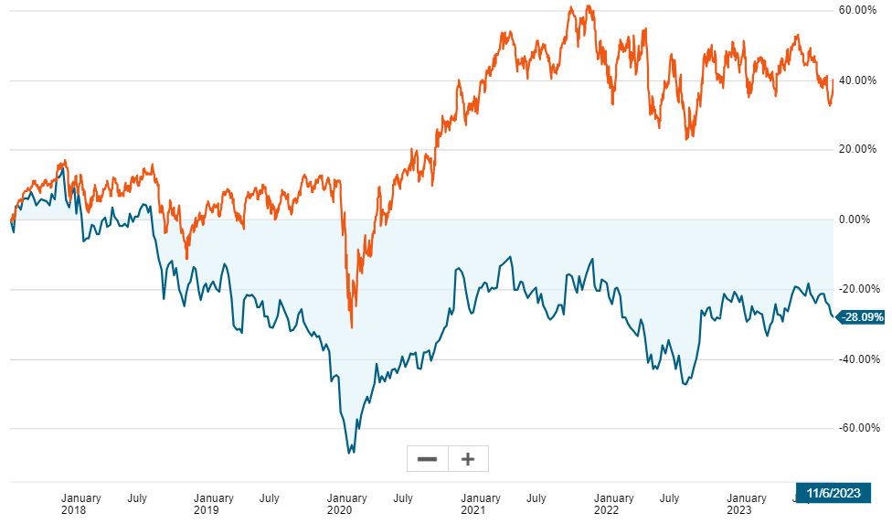
Litigation and reputational risk lingers a good while…
Dupont (DD) in blue.
Chemicals index in orange.

Slide 46
Shapira and Zingales (2023)
The authors propose avenues to strengthen existing deterrence mechanisms:
  Increase sanctions (criminal or punitive monetary)
  Reduce time lag between pollution detection and enforcement
  Increase probability of detection
    Qui Tam
    Stronger laws about Director oversight
    Broaden medical monitoring laws
  Taxing secret settlements
  Others?

Slide 47
Roadmap
Context: the US chemical industry and use
Mitigating damages: liability versus regulation
Information provision
Overview: federal regulation of chemicals
Shapira & Zingales, 2023
Wrapping up

Slide 48
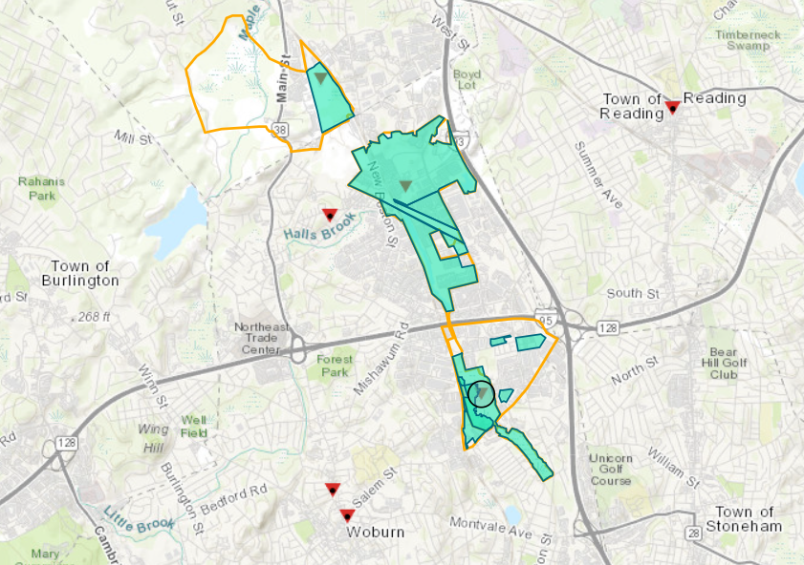
Back to Woburn, MA: 1980s to present
In 1982, the US EPA added the Wells G & H site to the Superfund National Priorities List.
In 1991, after nearly a decade of careful study, EPA finalized a $69.5 million settlement with four parties found liable for the cleanup of the Wells G & H Site.
Negotiations have led to additional settlements in more recent years. Over 80 companies that operated in the area since 1853 are suspected of contributing to the pollution…
More on the Superfund program to come Wednesday with Dr. Austin.

Slide 49
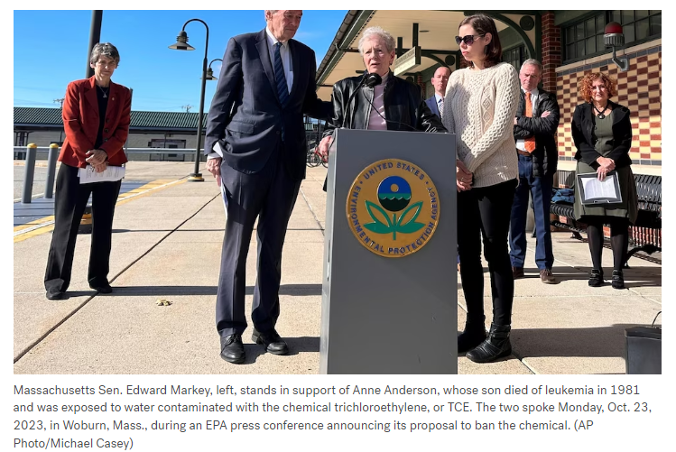
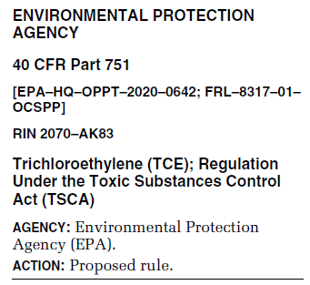
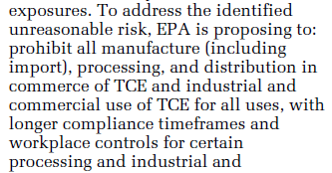
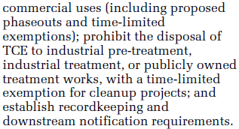
Woburn, MA: 10/23/2023

Slide 50
Next class
  Next class will cover CERCLA and RCRA.
  Beforehand: watch the Hazardous Waste documentary
  Reminder to keep making progress on Case Study #4 (due Nov 27)

